Slide 1

Final Project Report – Model Review
ISYE 6748
Piper Gradient
Dennis Morozov
7/18/2021

Slide 2
Index
1. Introduction
Motivation
Changes from Project Proposal
Ethics
2. Process
3. Data
Twitter
Text with Emotional Categories
Vocabulary with Emotional Categories
Cleaning
4. Benchmark Analysis and Visualization
Sentimental and Emotional Classification
Visualization and Relational Graphs
5. Convolutional Neural Net (CNN)
Configuration A
Configuration B
6. Final Data Classification and Visualization
Model Performance Review
Classified using best performing CNN

Slide 3
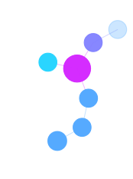
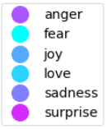
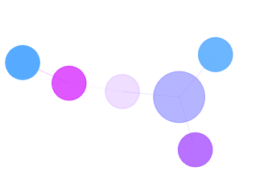
Introduction
Motivation
Misinformation spread by social media has a tangible impact on the real words, as witnessed by events within the last year. Algorithms used by social media companies can silo individuals in their affiliated groups, polarize conversations, and spread inflammatory topics within seconds. The dense connectivity, and the lack of human emotional insight on social media lacks crucial social clues that humans use in their physical interaction. These social and emotional clues help people judge how to respond to a particular event.
This Piper Gradient cap stone project attempts to add emotional context to tweets, and their underlining relational graphs. Emotional ques can inform users about the conversations they choose to participate in, and prepares the to respond with additional social context. Furthermore, the tweet emotional insights can be used by analysis to better understand how these sentiments are spread from tweet to tweet, and what emotions are dominant in different clusters (users or topical clusters).

Slide 4

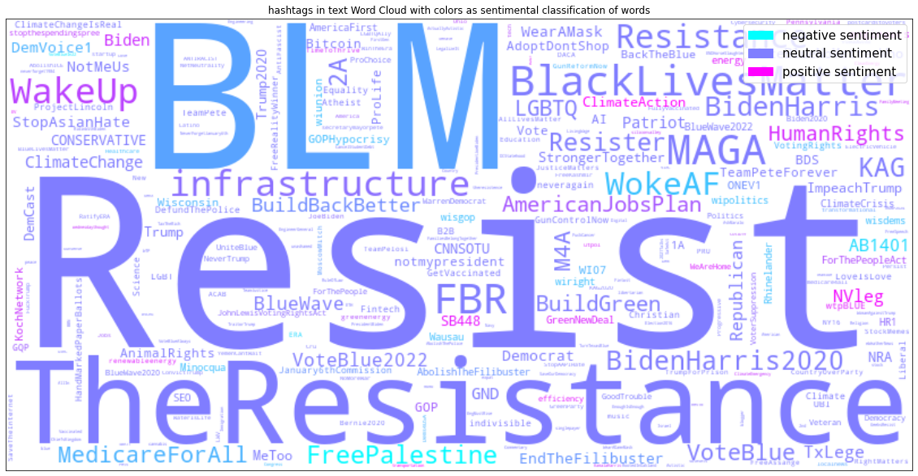
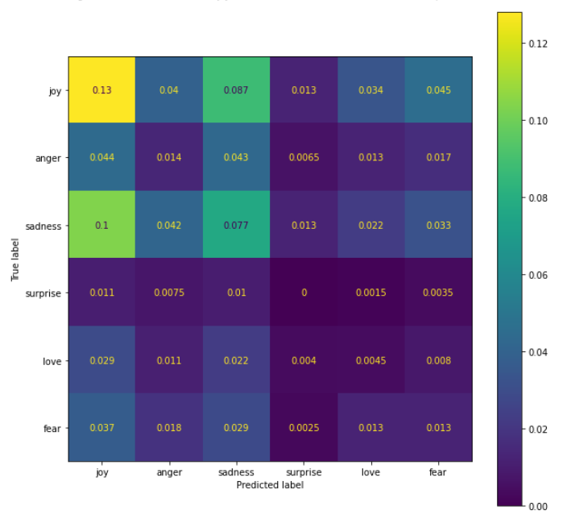
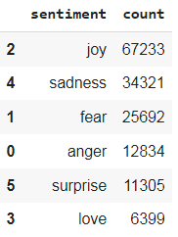
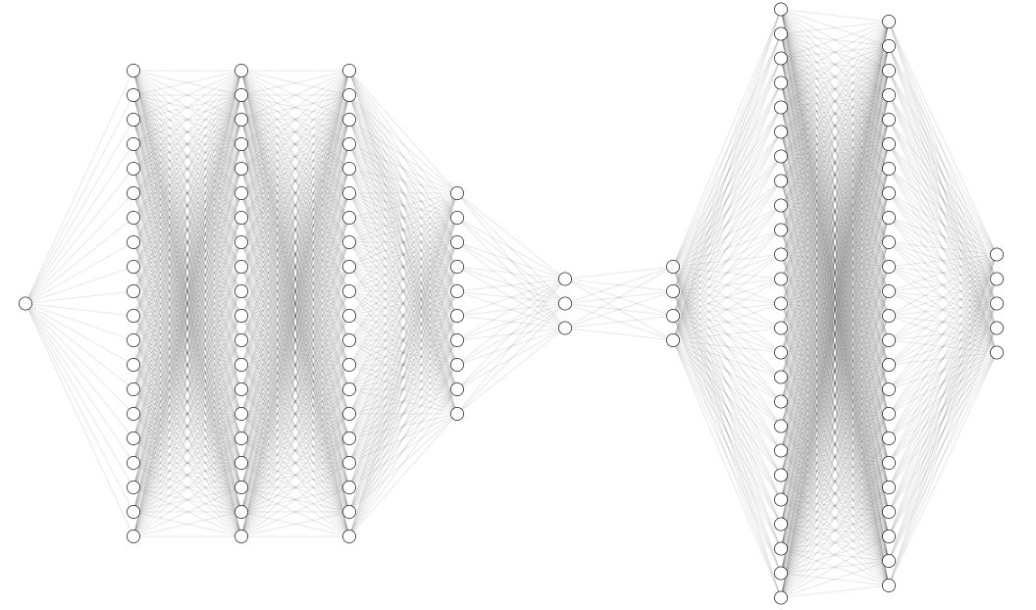
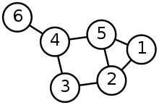
Process
Workflow Colab Notebook Process Flow
All codding work was done in google colab noteboosk. Several different notebooks were used to organize different stages of the modeling.
Results Visualization
CNN Train
and Validation
Model
Performance
Review
Classify
Data
with CNN
Build
Nodes and Edges
With new Classes
Grow
Relational Tree

Slide 5
Introduction
Changes from Project Proposal
The initial proposal focused on building a model that will assign a sentimental “grade” to a tweet based on the content of the text and previous tweets in the conversation chain. The initial goal was too broad and sentimental analysis models were not clearly defined.
The final approach was to focus on developing and understanding the model that will classify each tweet with a sentiment label. Specifically, the worked focused on exploring convolutional neural nets (CNN) with different configuration and evaluated their performance.
Additionally, staying with the initial proposal, the sentimental classification was applied to the tweeter data. Relational graph with an emotional context were generated to visualize results.

Slide 6
Introduction
Ethics
Much focus went into building a solid ethics base on ethics in machine learning and AI. The focused was driven by instructors, project requirements, and student impetus on discussion boards. The ethics review will be covered in detailed in the ethics presentation, however, here are a few bullet points that were considered throughout ML model design and testing.
Stakeholders:
Twitter (standing in for all twitter users and the company)
Student developing the model
Piper Gradient Instructors
Piper Gradient Project
Data was collected from traceable sources such as Kaggle and Twitter Model
Model performance was reviewed in detail with common metrics and evaluation techniques
From data collection to model testing, effort was put into making the processing as transparent as possible
Results are compared to benchmark cases for performance explicability

Slide 7
Data
Twitter
The data was collected using the twitter API by the Piper team and it was filtered around the topic of American Jobs or the Infrastructure Bill.
3 datasets are available for this project
Small – 47 k rows, used for developing and testing
Medium – 923 k rows, used to test and validate algorithms
Large – 93 million rows, used to perform final analysis
Kaggle Datasets with Emotional Labels:
Text with Emotional Categories:
Kaggle name: Emotions dataset for NLP
Kaggle usability score: 10
Vocabulary with Emotional Categories – Kaggle usability score of 8.2
Kaggle name: Emotions Sensor Data Set
Kaggle usability score: 8.2
Both Kaggle datasets have additional documentation for data generation, traceability and lifecycle.
The datasets were used to train CNN models to classify tweets with emotional labels

Slide 8
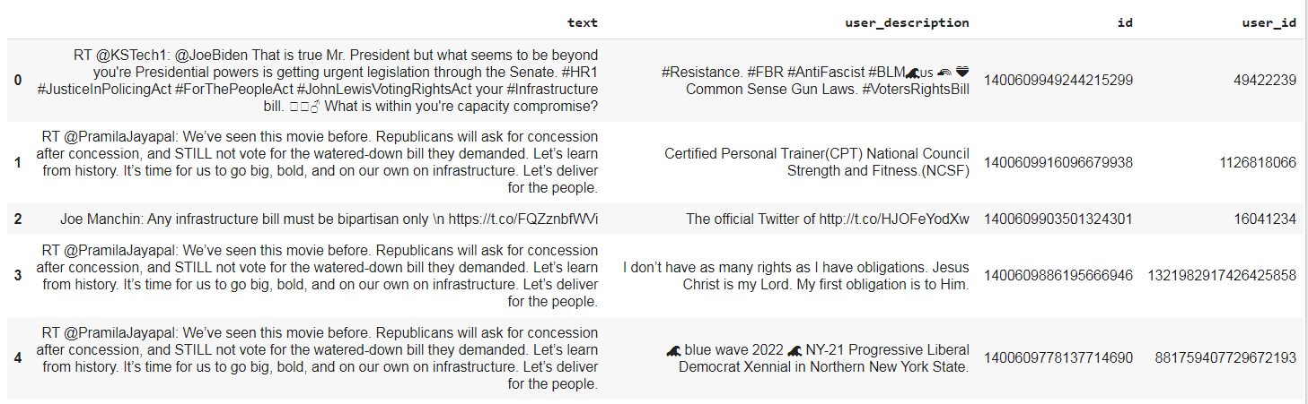
Data
Twitter Data Sample
Features
The data include twitter ids, user ids, response to twitter ids, actual text of the twitter, user profile descriptions and more.
Full list of columns: created_at', 'id', 'reply_to_id', 'screen_name', 'coordinates', 'place', 'retweet_count', 'favorite_count', 'lang', 'source', 'is_quote_status', 'user_id', 'user_loc', 'user_description', 'verified', 'followers_count', 'friends_count', 'favourites_count', 'statuses_count', 'listed_count', 'user_created_at', 'text'

Slide 9
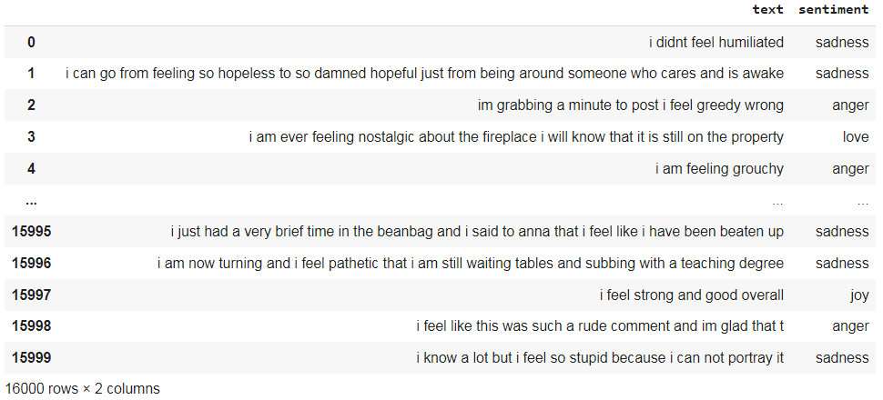
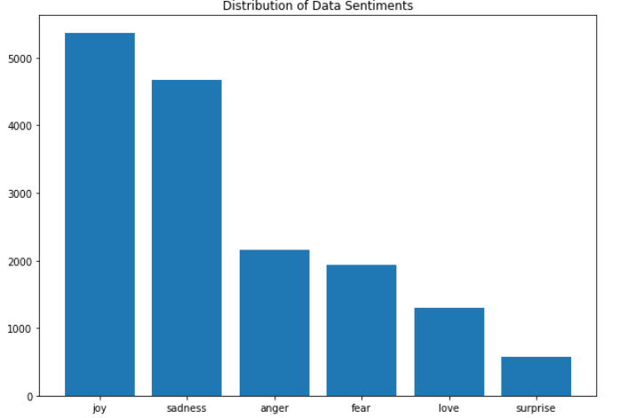
Data
Text with Emotional Categories
https://www.kaggle.com/praveengovi/emotions-dataset-for-nlp?select=train.txt

Slide 10
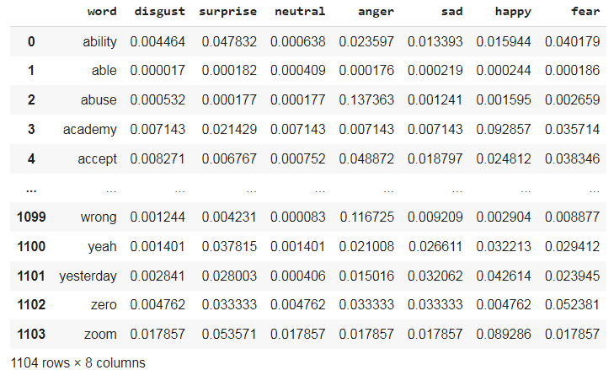
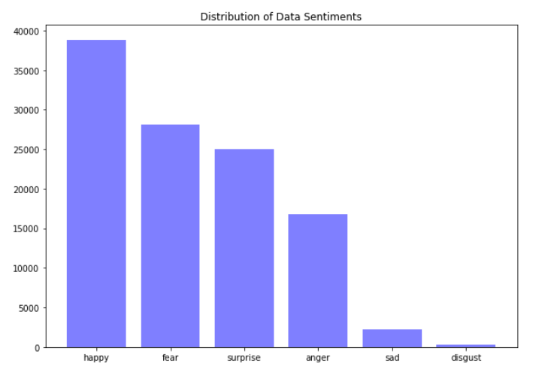
Data
Vocabulary with Emotional Categories
https://www.kaggle.com/iwilldoit/emotions-sensor-data-set

Slide 11
Data
Cleaning
Replace emojis with words ex: :) -> smiley face
Split joined words ex: SpamEmail -> spam email
Make all lowercase
Remove hash from hashtags ex: #happy -> happy
Remove \n and \r characters
Remove mentions ex: @michael published a book -> published a book
Remove websites
Remove numbers and punctuations
Remove non-english words
Lemmatize words

Slide 12
Data
Cleaning:
Before
After

Slide 13
Benchmark Analysis and Visualization
Sentimental and Emotional Classification
The initial emotional analysis classification was performed with Spacy library. The classification are either positive, neutral, or negative.
The simple classification schema allows us to get more familiar with the data, while building some benchmark bases for a more nuanced emotional classification.

Slide 14
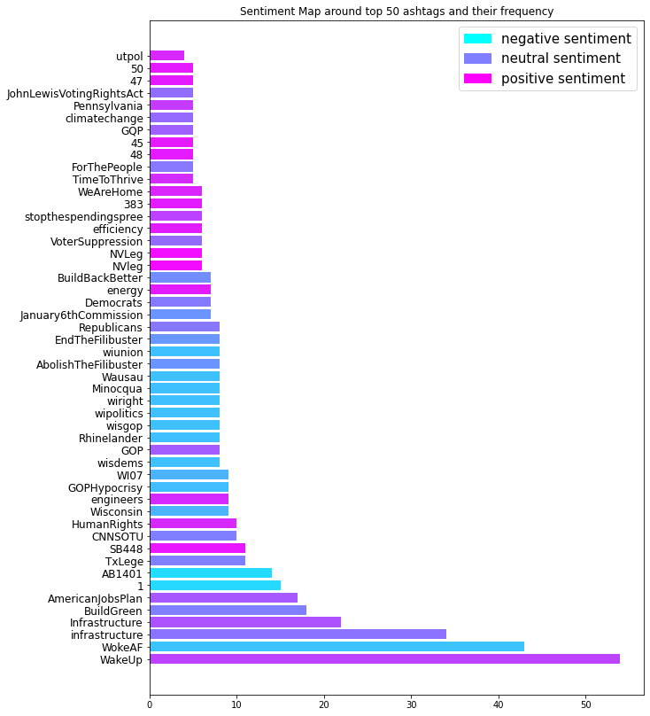
Benchmark Analysis and Visualization
Sentimental and Emotional Classification
Review of the top 50 hashtags by how often they are used.
The colors map out the hashtag's sentiment (negative, positive, and neutral)

Slide 15
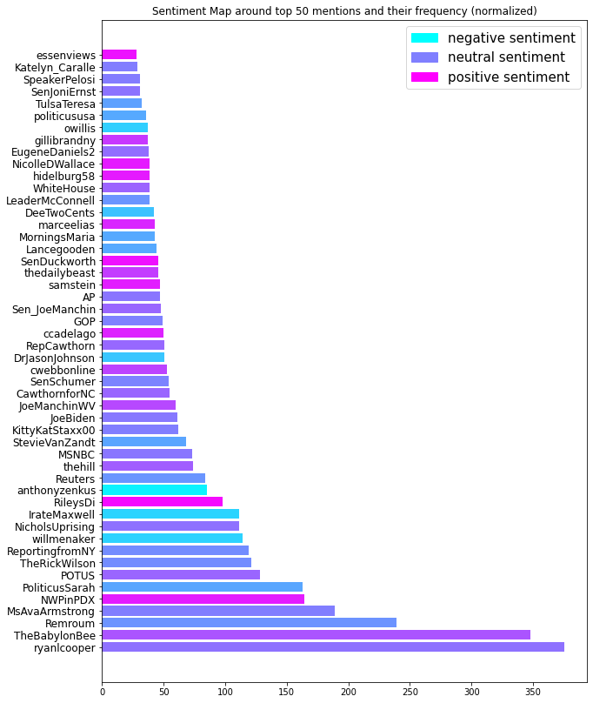
Benchmark Analysis and Visualization
Sentimental and Emotional Classification
Review of the top 50 users by how often they are mentioned by other users.
The colors map out the the kind of context the users are being mentioned (negative, positive, and neutral)

Slide 16
Benchmark Analysis and Visualization
Sentimental and Emotional Classification
A world cloud of the hashtags as used in the actual tweets, with their sentiment mapped to colors.

Slide 17
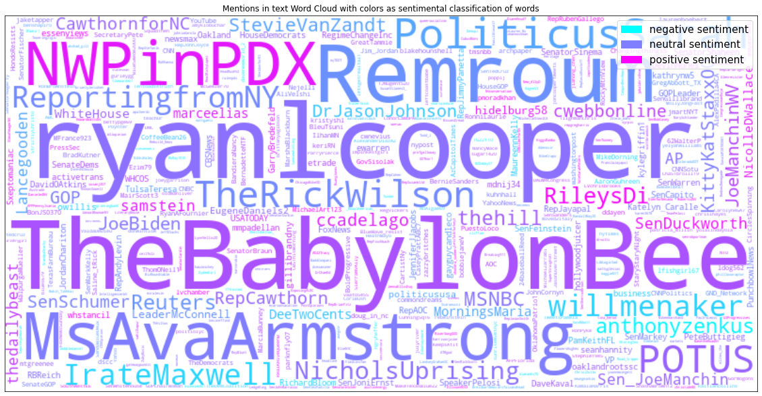
Benchmark Analysis and Visualization
Sentimental and Emotional Classification
A world cloud of user handles as mentioned by other users in their tweet, with their sentiment mapped to colors.

Slide 18
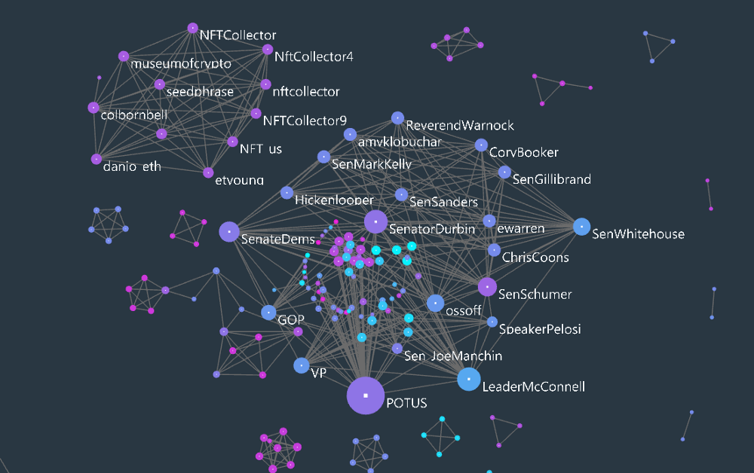
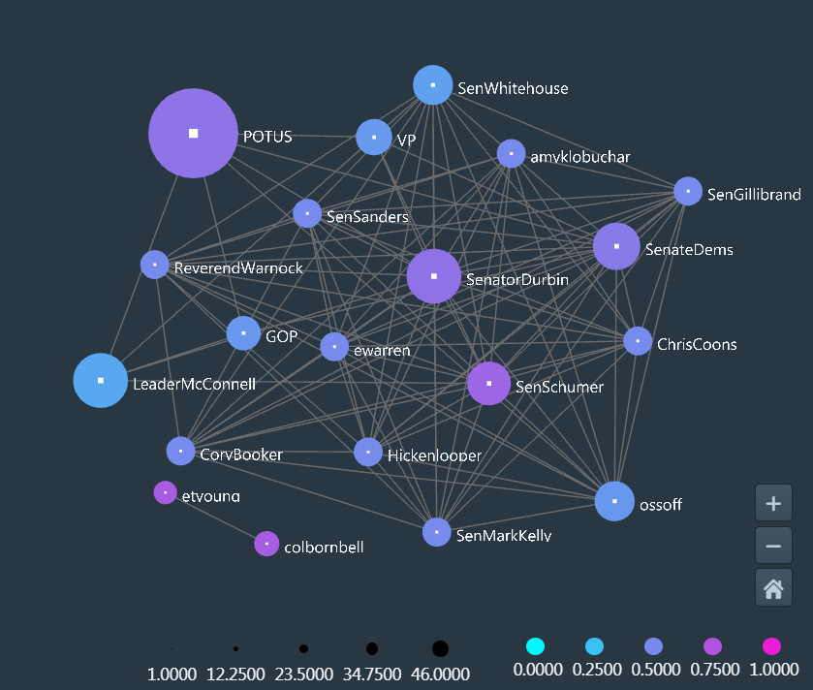
Benchmark Analysis and Visualization
Visualization and Relational Graphs
Mentions Relational Graph
https://poloclub.github.io/argo-graph-lite/#7a79ff2c-9f53-4c3c-ba5b-970346d5eabc
Top 20 Mentions Relational Graph
https://poloclub.github.io/argo-graph-lite/#ecdf31e1-15fa-4f50-a8c1-0c48c3228303

Slide 19
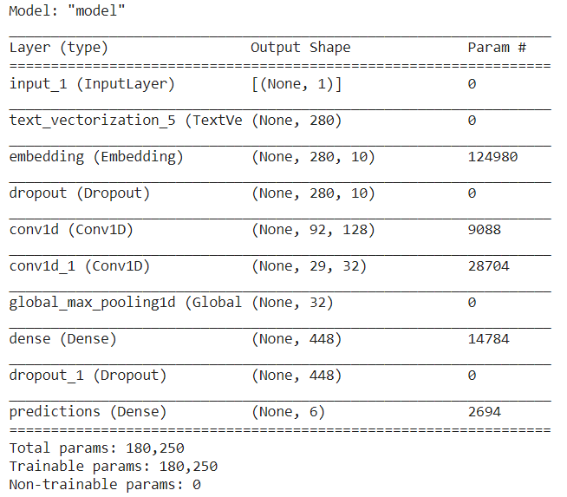
Convolutional Neural Net (CNN)
Configuration A
TensorFlow and Keras libraries were used to build the neural net.
First configuration is a simple CNN model with only one iteration of Convolution and max pooling.

Slide 20
Convolutional Neural Net (CNN)
Configuration A
Vectorize Text
Embedding Layer
Dense Layer
Dropout
Dropout
Convolution Layer
Dense Layer with Softmax Prediction
Convolution Layer
Max Pooling Layer
fear
love
joy
sadness
anger
surprise
Single body of text as input

Slide 21
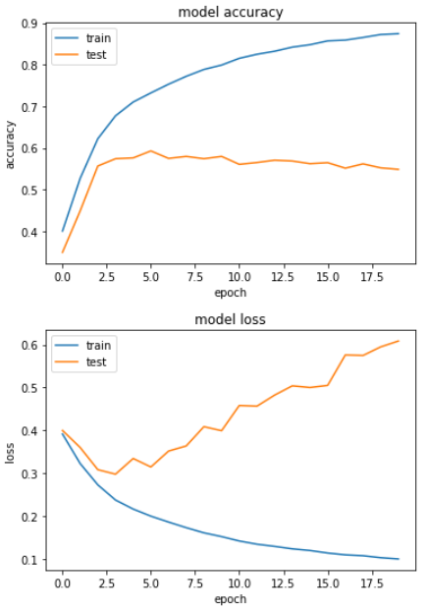
Convolutional Neural Net (CNN)
Configuration B Model Performance
Training Performance metrics
Test loss doesn't converge as does the trained model.

Slide 22
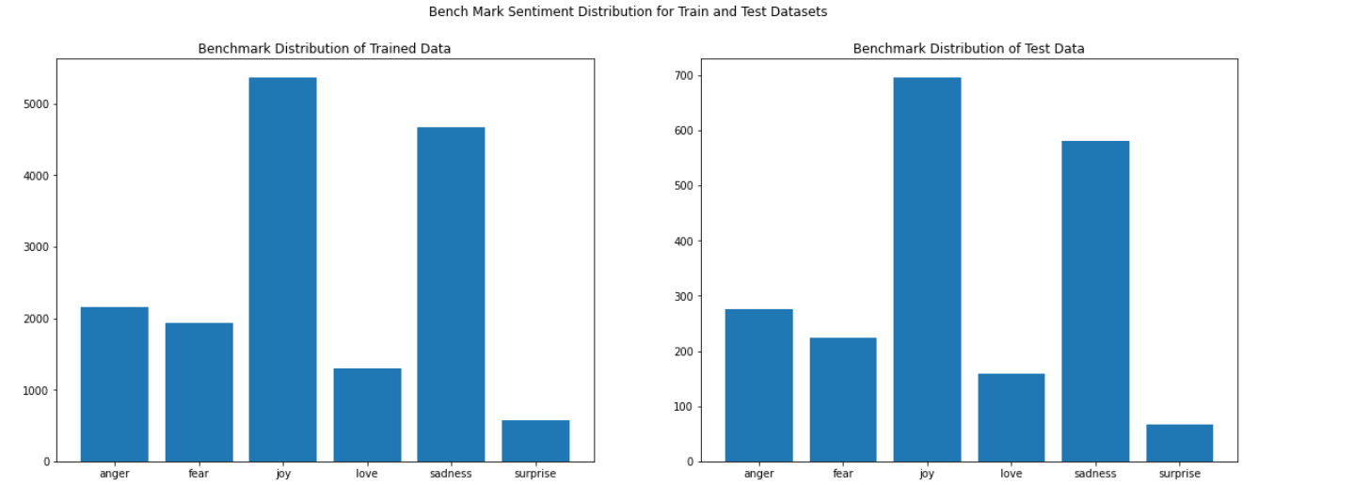
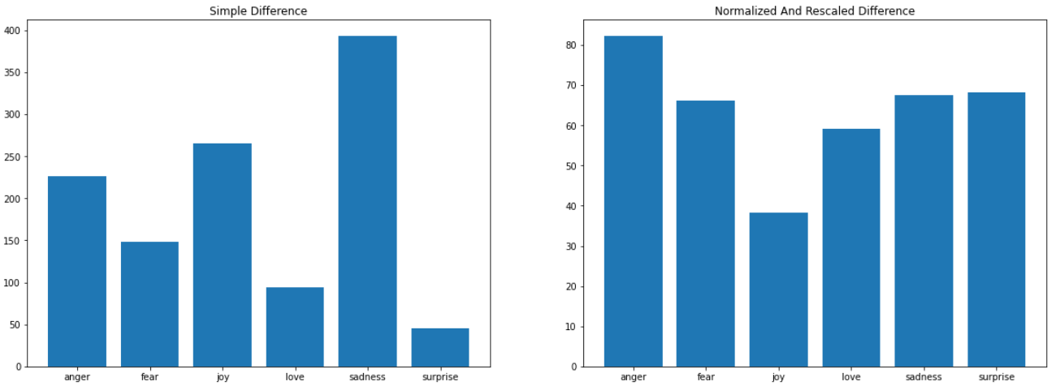
Convolutional Neural Net (CNN)
Configuration A Performance a deeper look:

Slide 23
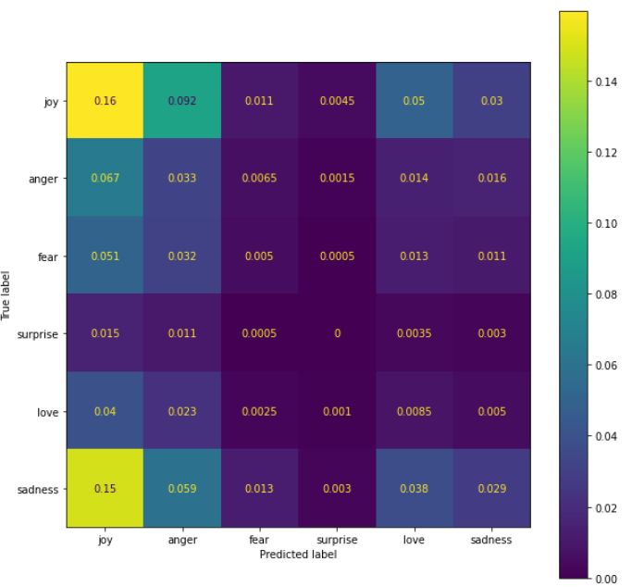
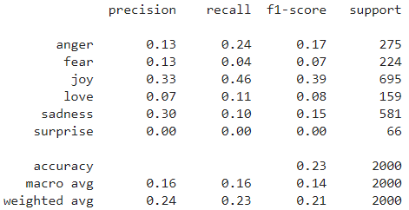
Convolutional Neural Net (CNN)
Configuration A Performance a deeper look:

Slide 24
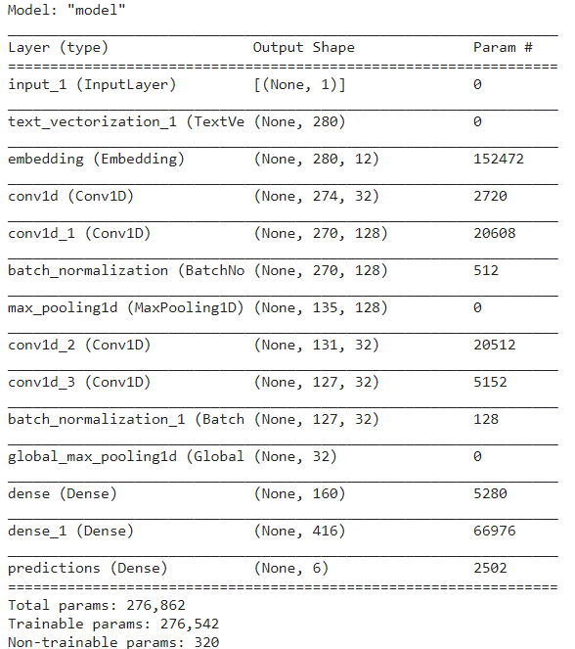
Convolutional Neural Net (CNN)
Configuration B
CNN with two iterations of convolution and max-pooling.
Additionally, the dropout layer was replaced with bath normalization

Slide 25
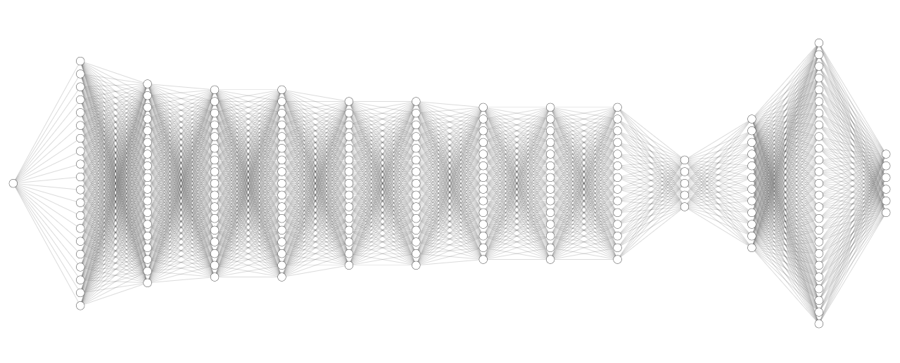
Convolutional Neural Net (CNN)
Configuration B
Vectorize Text
Embedding Layer
Dense Layer
Convolution Layer
Convolution Layer
Batch normalization
Max Pooling
Convolution Layer
Convolution Layer
Batch normalization
Dense Layer
Dense Layer with Softmax Prediction
Max Pooling
fear
love
joy
sadness
anger
surprise
Single body of text as input

Slide 26
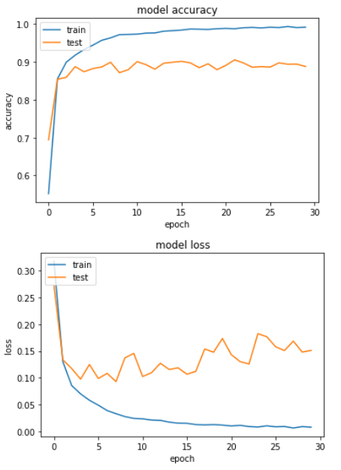
Convolutional Neural Net (CNN)
Configuration B Model Performance
At the first glance the model seems to train and validate very well.

Slide 27
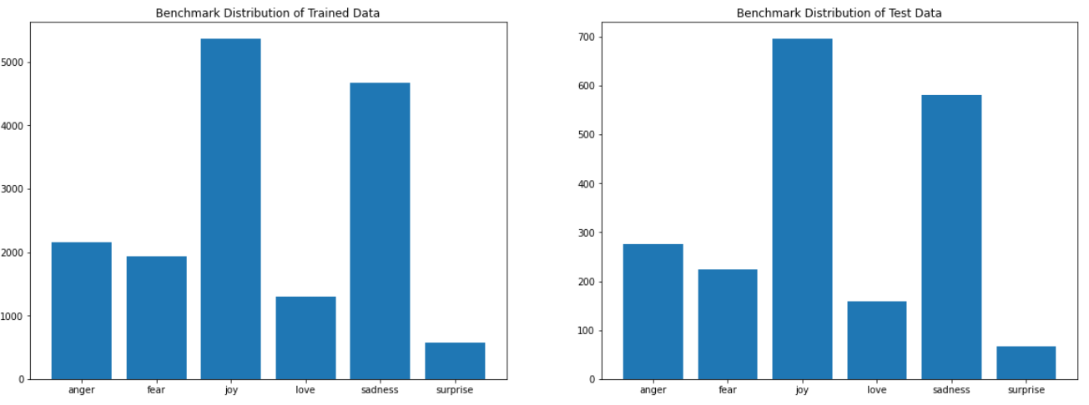
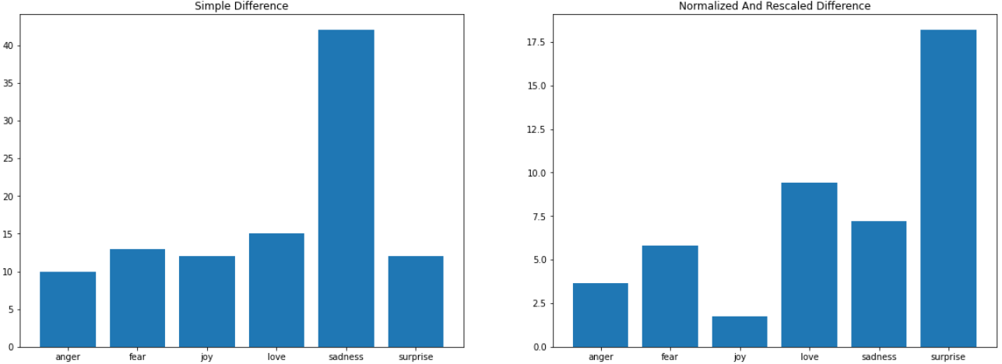
Convolutional Neural Net (CNN)
Configuration B Performance a deeper look:

Slide 28
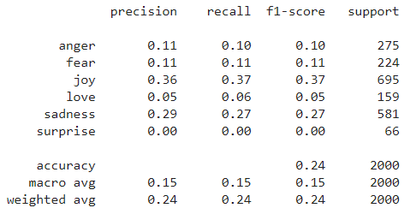
Convolutional Neural Net (CNN)
Configuration B Performance a deeper look:

Slide 29
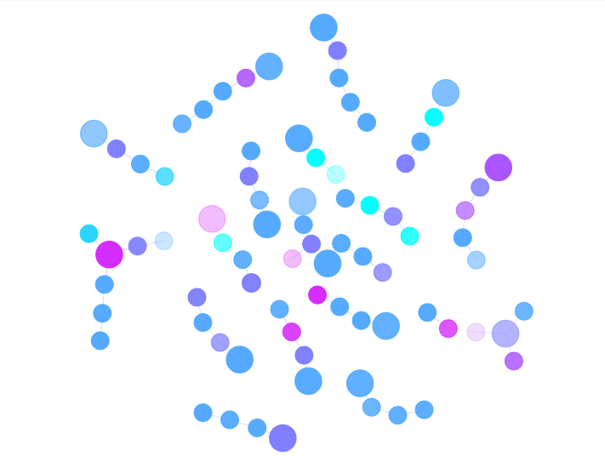
Convolutional Neural Net (CNN)
Final Data Classification and Visualization
Each node is a single tweet
Each edge represents a response to a tweet
The bigger node in each chain represents the root node, all other in the chain make up all the replies.
Color represents sentiment, and opacity or alpha, is how strong the indication was for the particular sentiment.

Slide 30
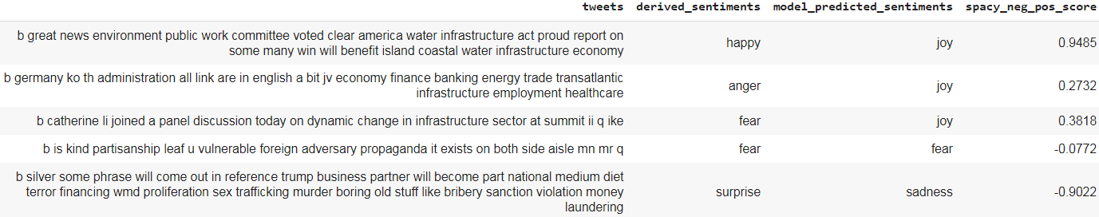
Convolutional Neural Net (CNN)
Dataset Challenges
Derived sentiments used a vector distance calculation between each tweet vector and a predefined vocabulary with sentimental labels. Tweet vector distance was then used to assign a label to each tweet as another benchmark measure.
Spacy sentiment prediction can be interpreted as -1 negative 0 neutral and 1 as positive.
CNN model predicted labels can then be compared to both Spacy, vector derived sentiments, and heuristically to the actual text.

Slide 31
Convolutional Neural Net (CNN)
Dataset Challenges
Either initial query parameters, or how data was cleaned and up filtered later by the piper team, left many response ids missing from the datasets.
Thus, the relational graphs are incomplete, and the true insight that can be gained is yet to be realized by a larger dataset.

